Slide 2
Agenda
Introducción
Microservicios
Docker Swarm
Docker service

Slide 3


Slide 4
Introduction
For many years now, we have been finding better ways to build systems.
We have been learning from what has come before, adopting new technologies, and observing how a new wave of technology companies operate in different ways to create IT systems that help make both their customers and their own developers happier.
Our understanding of how the web works has led us to develop better ways of having machines talk to other machines.

Slide 5
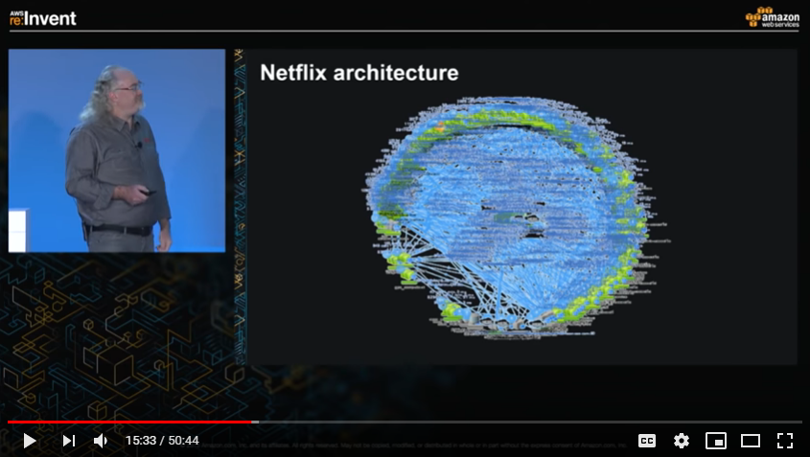
Netflix – 2015 – microservicios

Slide 6
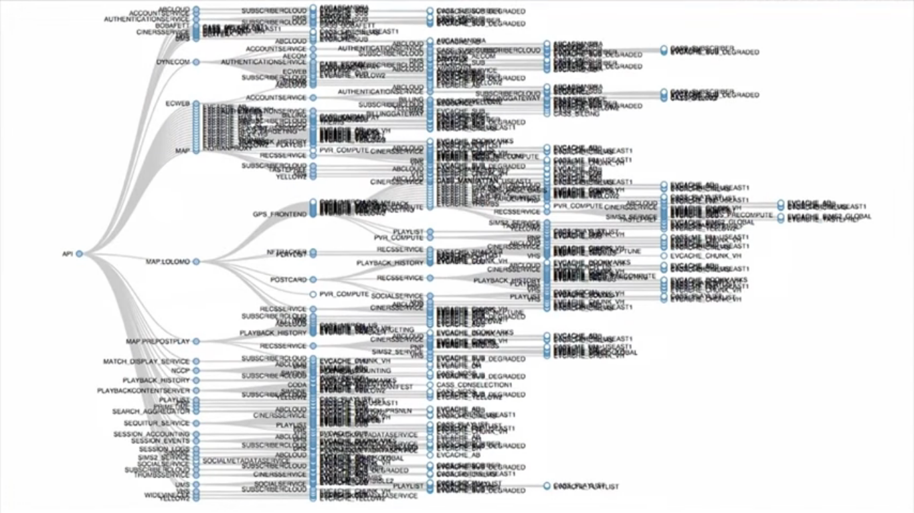
Netflix – 2015 – llamados entre microservicios

Slide 7
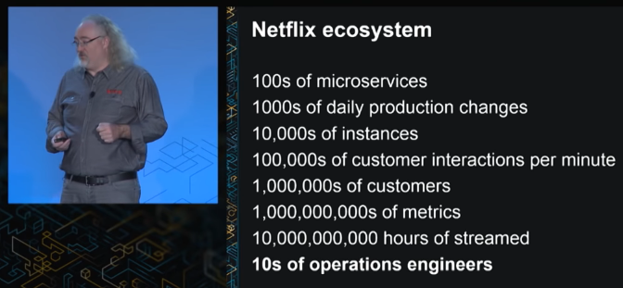
Netflix – 2015 – Ecosystem
¿Qué observa de raro?
¿A qué se debe que se puedan realizar miles de cambios diarios?
https://www.youtube.com/watch?v=-mL3zT1iIKw

Slide 8
Agenda
Introducción
Microservicios
Docker Swarm
Docker service

Slide 9
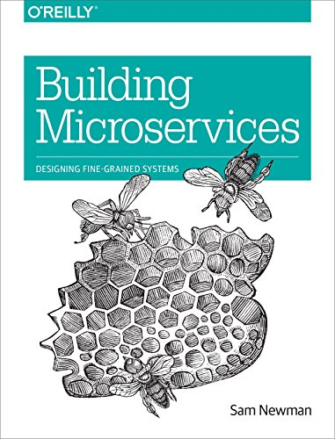
Microservices
Microservices are small, autonomous services that work together.
Let’s break that definition down a bit and consider the characteristics that make microservices different.

Slide 10
1) Small, and Focused on Doing One Thing Well
Codebases grow as we write code to add new features.
Over time, it can be difficult to know where a change needs to be made because the codebase is so large.
How small is small?
Giving a number for lines of code is problematic.
Jon Eaves at RealEstate.com.au in Australia characterizes a microservice as something that could be rewritten in two weeks.
“I nearly always ask the question who has a system that is too big and that you’d like to break down? Nearly everyone raises their hands. We seem to have a very good sense of what is too big, and so it could be argued that once a piece of code no longer feels too big, it’s probably small enough”.

Slide 11
2) Autonomous
Our microservice is a separate entity.
It might be deployed as an isolated service on a platform as a service (PAAS), or it might be its own operating system process.
We try to avoid packing multiple services onto the same machine, although the definition of machine in today’s world is pretty hazy!
All communication between the services themselves are via network calls.
These services need to be able to change independently of each other, and be deployed by themselves without requiring consumers to change.
Our service exposes an application programming interface (API), and collaborating services communicate with us via those APIs.

Slide 12

Key benefits of microservices?

Slide 13
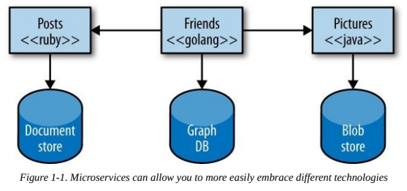
1) Technology Heterogeneity
With a system composed of multiple, collaborating services, we can decide to use different technologies inside each one.
If one part of our system needs to improve its performance, we might decide to use a different technology stack that is better able to achieve the performance levels required.

Slide 14

2) Resilience
In a monolithic service, if the service fails, everything stops working.
However, with microservices if one component (service) fails, that failure doesn’t cascade, and you can isolate the problem and the rest of the system can carry on working.

Slide 15
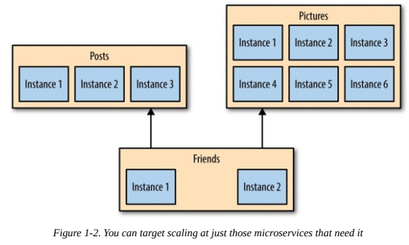
3) Scaling
With a large, monolithic service, we have to scale everything together.
With smaller services, we can just scale those services that need scaling.

Slide 16
4) Ease of Deployment
A one-line change to a million-line-long monolithic application requires the whole application to be deployed in order to release the change.
With microservices, we can make a change to a single service and deploy it independently of the rest of the system.
5) Composability
One of the key promises of distributed systems and service-oriented architectures is that we open up opportunities for reuse of functionality.
With microservices, we allow for our functionality to be consumed in different ways for different purposes.

Slide 17
6) Optimizing for Replaceability
If you work at a medium-size or bigger organization, chances are you are aware of some big, nasty legacy system sitting in the corner.
Maybe you have asked “Why hasn’t it been replaced?” You know why: it’s too big and risky a job.
With our individual services being small in size, the cost to replace them with a better implementation, or even delete them altogether, is much easier to manage.

Slide 18
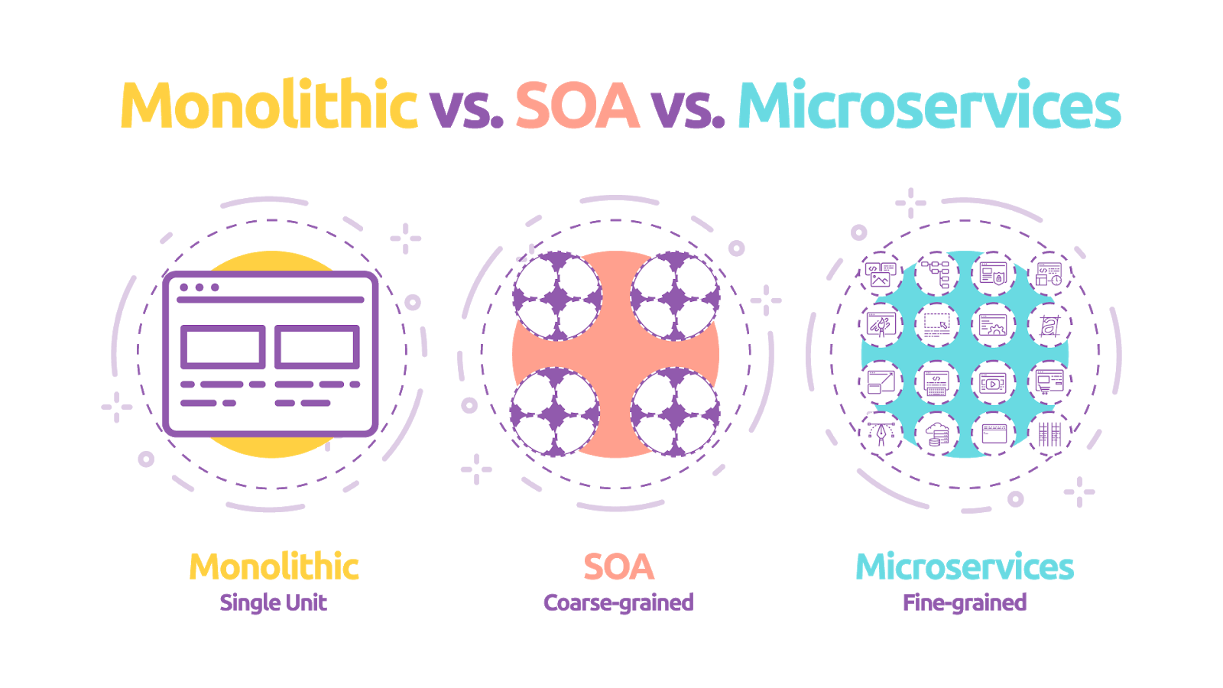
SOA vs microservices
The microservice approach has emerged from real-world use, taking our better understanding of systems and architecture to do SOA well.

Slide 19

Gilt Case
Gilt an online fashion retailer that started in 2007.
Gilt’s monolithic Rails application was starting to become difficult to scale, and the company decided in 2009 to start decomposing the system into microservices.
A year later, Gilt had around 10 microservices live. By 2012, over 100. And in 2014, over 450 microservices by Gilt’s own count — in other words, around three services for every developer in Gilt.

Slide 20
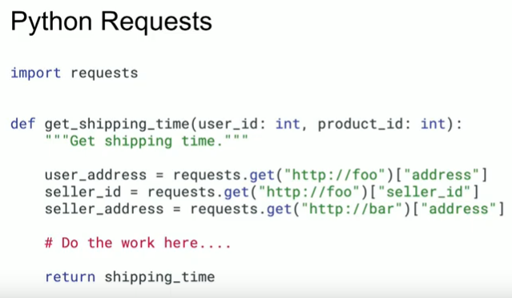
Ejemplo Mercadolibre
Charla “Conectando microservicios con Python”, por Rodolfo E. Edelmann.
¿En qué parte de este código se ve el llamado a microservicios?
https://www.youtube.com/watch?v=lITNAI_u9LE

Slide 21
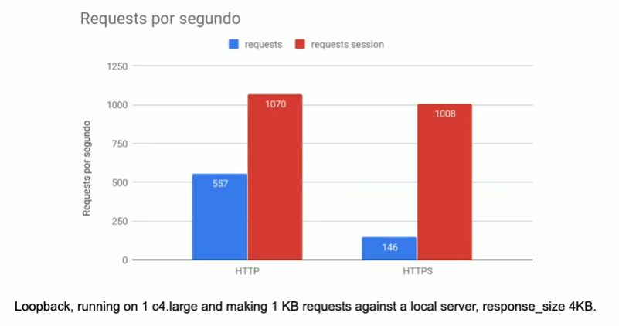
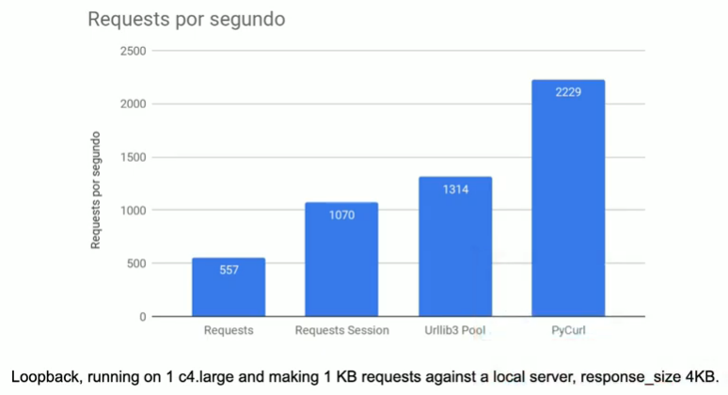
Ejemplo Mercadolibre – II

Slide 22
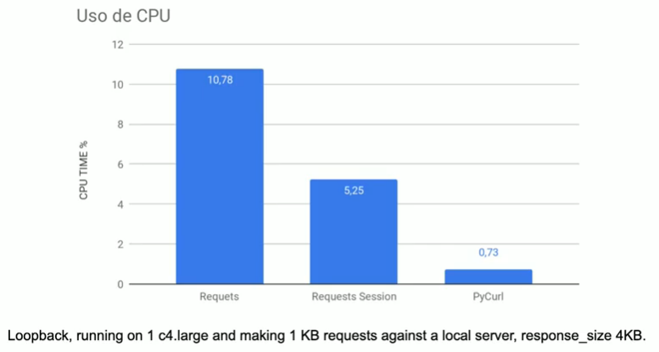
Ejemplo Mercadolibre – III

Slide 23
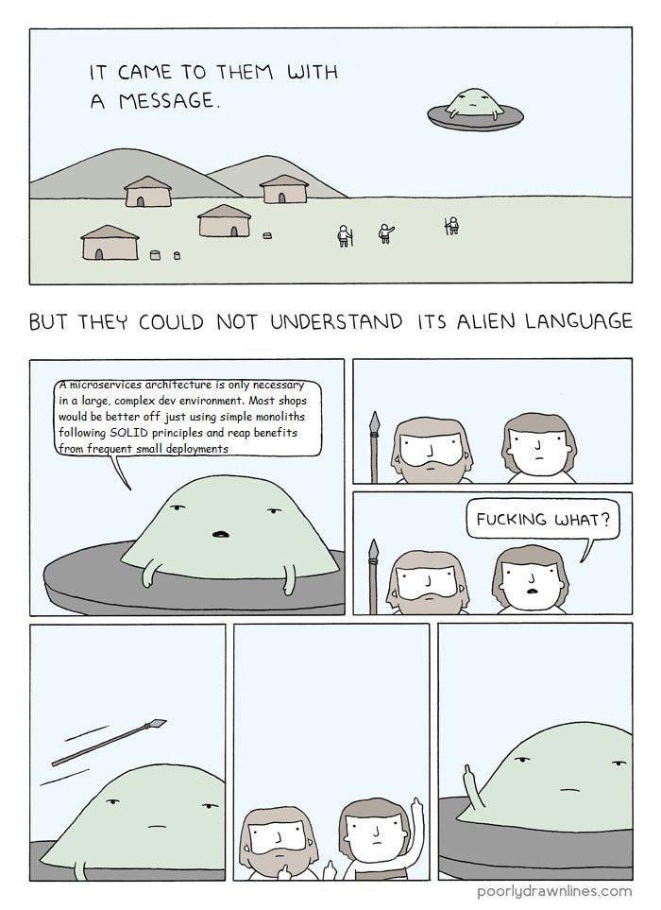
“A microservices architecture is only necessary in a large, complex dev environment. Most shops would be better off just using simple monoliths following SOLID principles and getting benefits from frequent small deployments.”

Slide 24

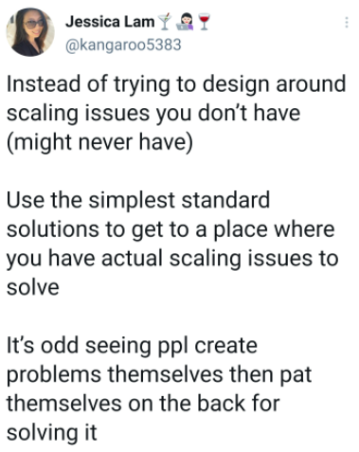

Slide 25

A good architecture will allow a system to be born as a monolith, deployed in a single file, but then to grow into a set of independently deployable units, and then all the way to independent services and/or micro-services. Later, as things change, it should allow for reversing that progression and sliding all the way back down into a monolith.
- Robert C. Martin

Slide 26
Agenda
Introducción
Microservicios
Docker Swarm
Docker service

Slide 27
Docker Swarm
Hasta el momento, los ejemplos que hemos diseñado en este curso han funcionado como aplicaciones Docker totalmente aisladas.
Esto puede ser útil para ciertos casos, pero el gran problema es que no escala muy bien.
Docker provee una alternativa para solucionar este problema llamada Docker Swarm.
Docker Swarm es básicamente una manera de enlazar nodos (hosts), administrar esos nodos y finalmente, que las aplicaciones Dockerizadas que corran en esos nodos sean eficientes y fáciles de escalar.
En pocas palabras, Docker Swarm es un grupo de nodos Docker conectados y administrados como un clúster o “enjambre” (swarm).

Slide 28
Docker Swarm – características
Cluster management integrated with Docker Engine: Use the Docker Engine CLI to create a swarm of Docker Engines where you can deploy application services. You don’t need additional orchestration software to create or manage a swarm.
Decentralized design: Instead of handling differentiation between node roles at deployment time, the Docker Engine handles any specialization at runtime. You can deploy both kinds of nodes, managers and workers, using the Docker Engine.
Service discovery: Swarm manager nodes assign each service in the swarm a unique DNS name and load balances running containers.
Scaling: For each service, you can declare the number of tasks you want to run. When you scale up or down, the swarm manager automatically adapts by adding or removing tasks to maintain the desired state.
Desired state reconciliation: The swarm manager node constantly monitors the cluster state and reconciles any differences between the actual state and your expressed desired state. For example, if you set up a service to run 10 replicas of a container, and a worker machine hosting two of those replicas crashes, the manager creates two new replicas to replace the replicas that crashed.
¿A qué se le parece de lo que hicimos la semana pasada?

Slide 29
Docker node (host)
A node is an instance of the Docker engine participating in the swarm.
A given Docker node can be a manager, a worker, or perform both roles.
Manager nodes dispatch units of work called tasks to worker nodes. Manager nodes also perform the orchestration and cluster management functions required to maintain the desired state of the swarm. Manager nodes elect a single leader to conduct orchestration tasks.
Worker nodes receive and execute tasks dispatched from manager nodes. By default, manager nodes also run services as worker nodes, but you can configure them to run manager tasks exclusively and be manager-only nodes.

Slide 30
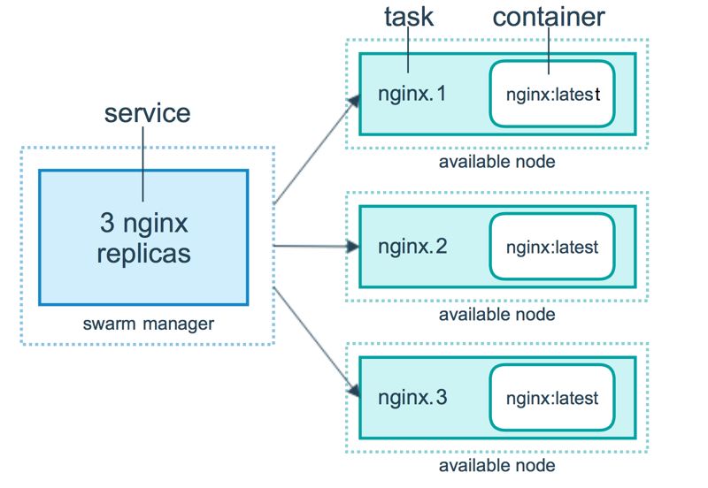
Docker nodes (hosts) – II
Note: if a worker node becomes unavailable, Docker schedules that node’s tasks on other nodes. A task is a running container which is part of a swarm service and managed by a swarm manager, as opposed to a standalone container.

Slide 31
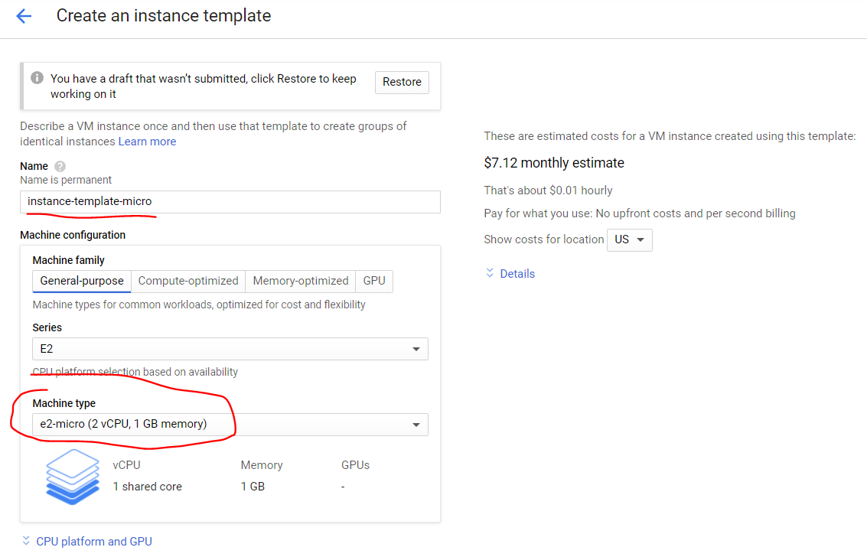
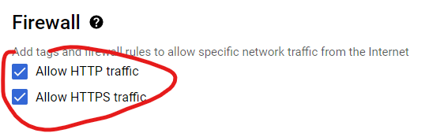
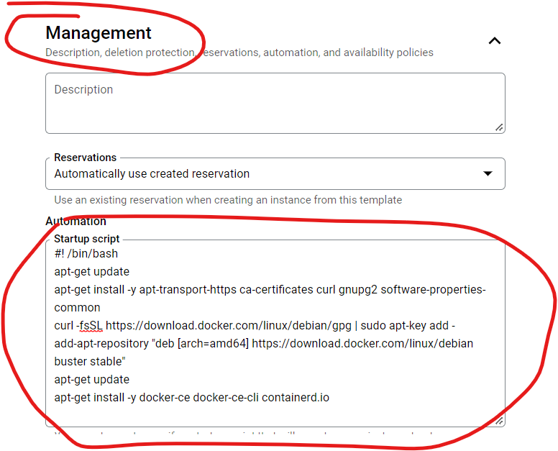
GCP – instance templates

Slide 32
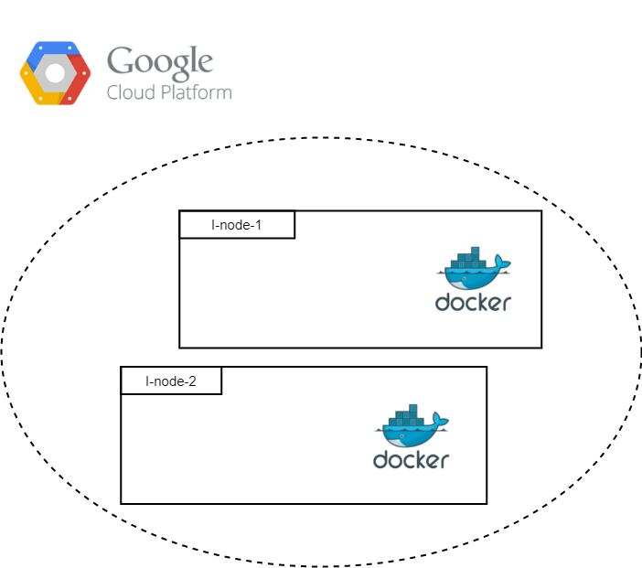
Arquitectura inicial

Slide 33
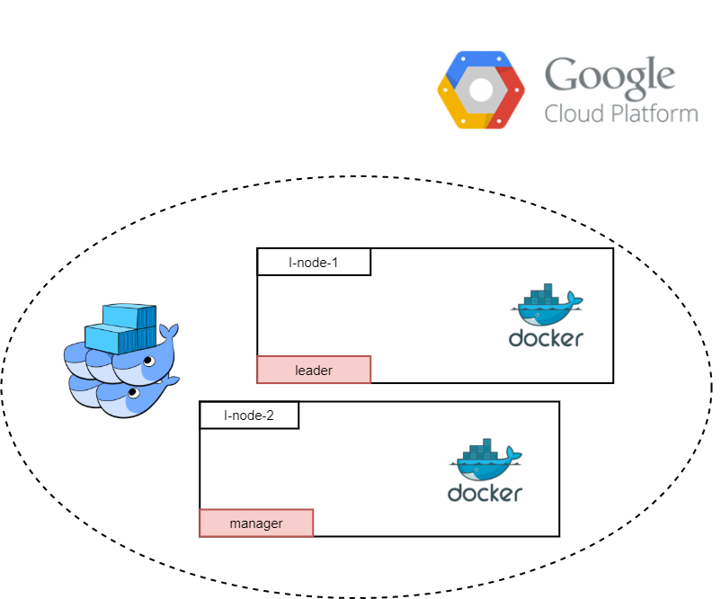
Docker Swarm
Para empezar a trabajar con Docker Swarm se debe hacer lo siguiente.
En el nodo 1 (leader) se debe inicializar el Swarm.
En el nodo 1 se obtiene el comando de unión para otros nodos managers
En el nodo 2 (manager) se ejecuta el comando de unión como manager

Slide 34
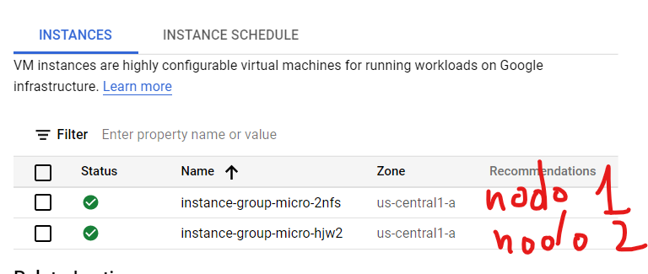
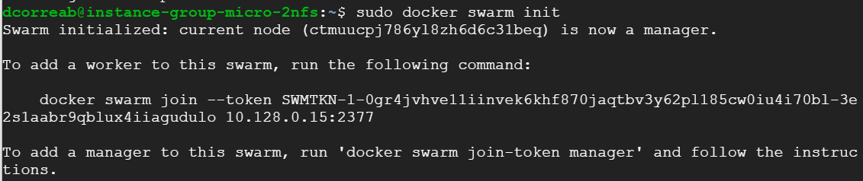
Randomquotes – nodes

Slide 35
Agenda
Introducción
Microservicios
Docker Swarm
Docker service

Slide 36
Docker service
A service is the definition of the tasks to execute on the manager or worker nodes.
It is the central structure of the swarm system and the primary root of user interaction with the swarm.
When you create a service, you specify which container image to use and which commands to execute inside running containers.
In the replicated services model, the swarm manager distributes a specific number of replica tasks among the nodes based upon the scale you set in the desired state.

Slide 37
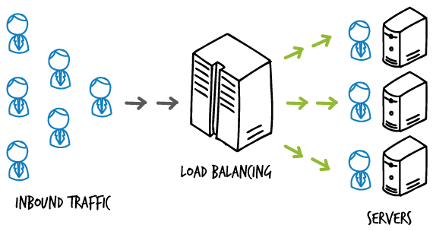
Docker service – Load balancing
Swarm mode has an internal DNS component that automatically assigns each service in the swarm a DNS entry. The swarm manager uses internal load balancing to distribute requests among services within the cluster based upon the DNS name of the service.

Slide 38
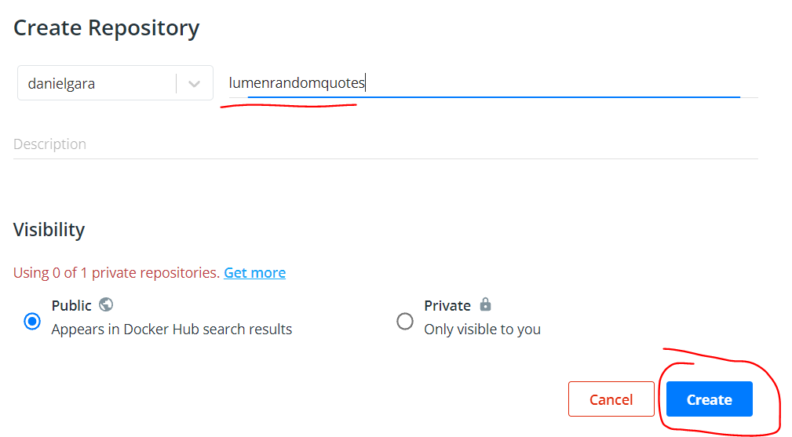
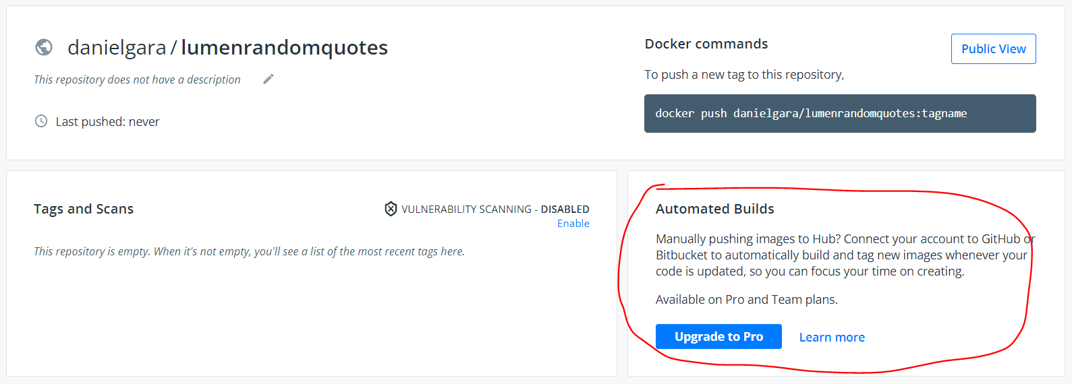
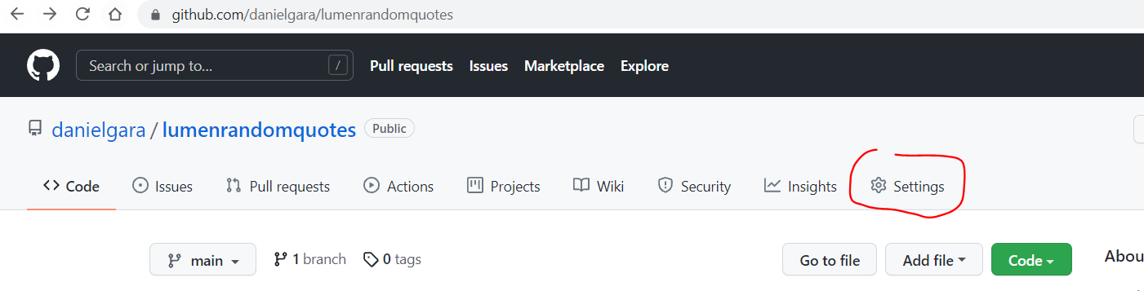
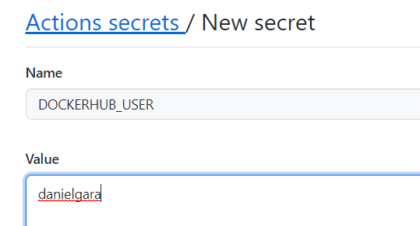
GitHub + GitHub Actions + DockerHub
Una buena estrategia es montar nuestros proyectos dockerizados en DockerHub. De esta manera, podremos descargar la imagen de nuestros proyectos desde cualquier parte, y crear contenedores en segundos.
Anteriormente DockerHub tenia una versión gratuita que permitía crear una nueva imagen cada vez que se hacia un push a un repo especifico.

Slide 39
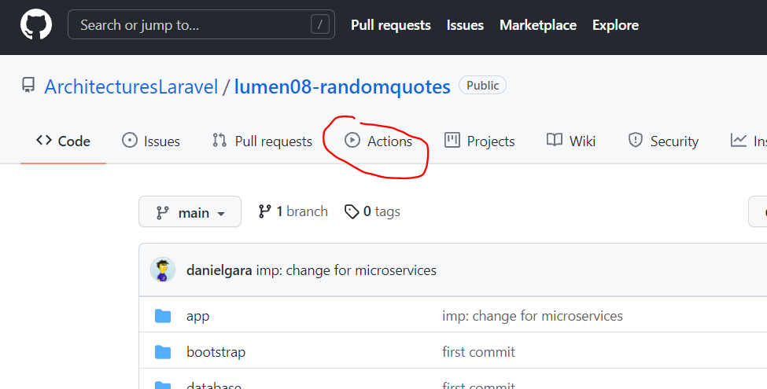
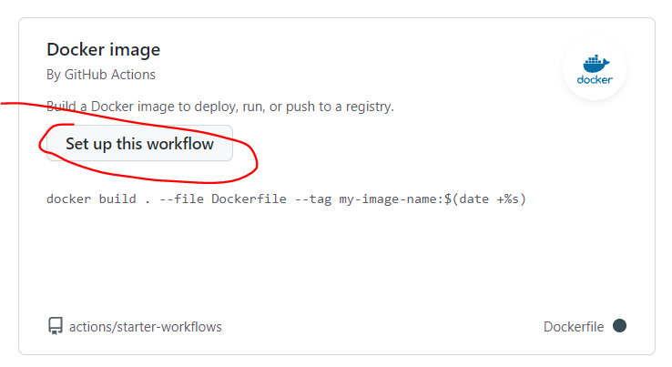
GitHub + GitHub Actions + DockerHub – II
GitHub Actions permite crear flujos de trabajo (workflows) que se pueden utilizar para compilar, probar y desplegar código, dando la posibilidad de crear flujos de integración y despliegue continuo dentro del propio repositorio de git.

Slide 40
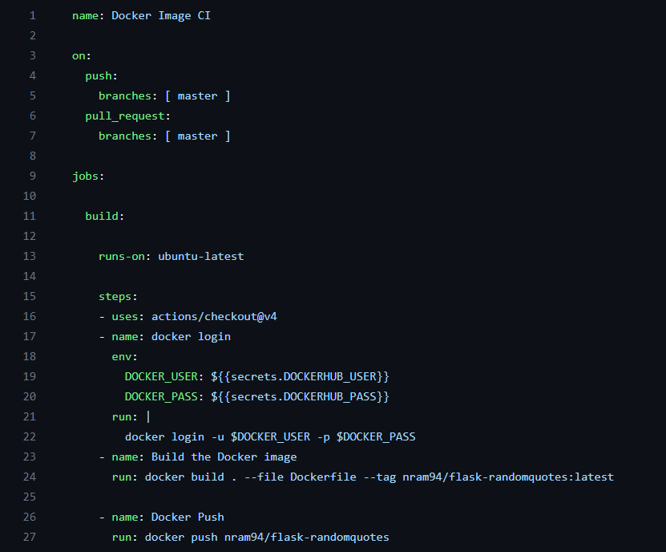
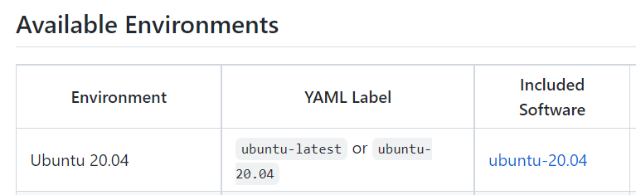
GitHub + GitHub Actions + DockerHub – III
Especificamos un flujo de trabajo que se ejecuta cuando hay un “push” o “pull request” a la rama “master”.
Creamos un trabajo que corre una maquina Ubuntu, y descargamos el código del repo.
Nos logueamos en Docker desde la maquina Ubuntu, construimos la imagen, y la montamos a nuestro repo en DockerHub.

Slide 41
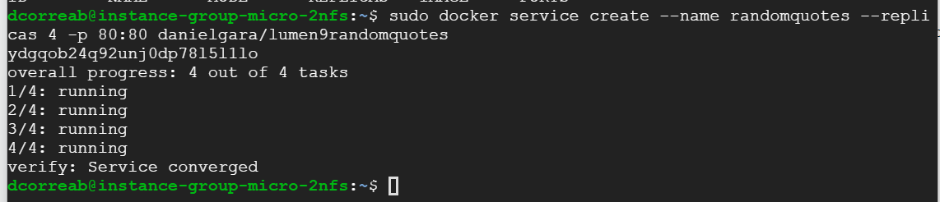
Randomquotes – service
Anteriormente montamos el proyecto de randomquotes en DockerHub para no tener que instalar la imagen en cada nodo, y darle acceso global

Slide 42
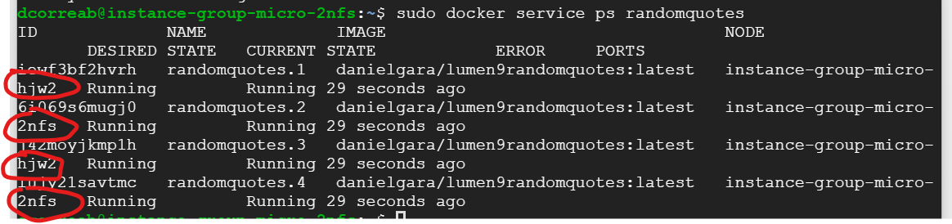
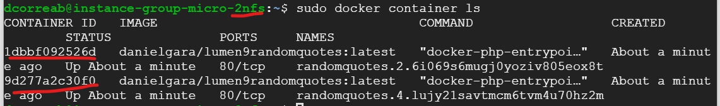
Randomquotes – service – II

Slide 43

Randomquotes – service – III
¿Y qué pasaba cuando borrábamos un contenedor a la fuerza?

Slide 44
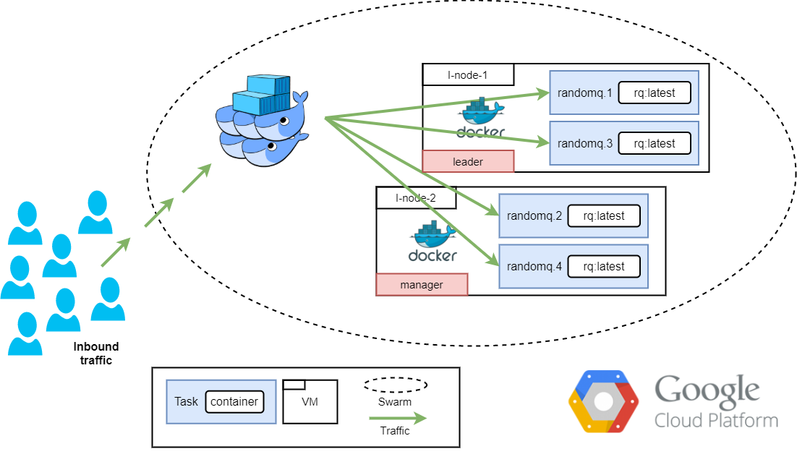
Arquitectura final

Slide 45
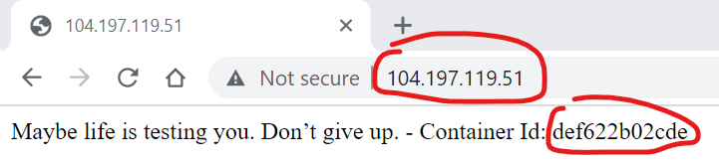
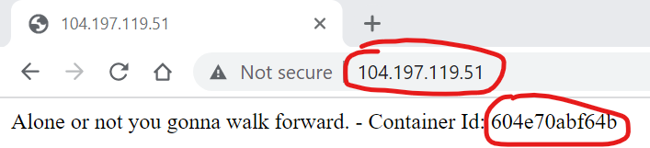
Randomquotes – service – III

Slide 46
Extra – Docker stack
En este curso (por cuestiones de tiempo), solo veremos aplicaciones “tipo microservicios” compuestas de un único servicio.
Sin embargo, en el mundo real, las aplicaciones están compuestas de múltiples servicios (bases de datos, front-end, backend, servicios externos, etc).
Administrar esas aplicaciones con lo visto hasta el momento seria muy complejo. Pero, afortunadamente Docker provee dos funcionalidades para administrar ese tipo de aplicaciones complejas:
Docker compose: se utiliza cuando se desea administrar aplicaciones que requieren comunicar múltiples contenedores.
Docker stack (evolución de Docker compose): se utiliza cuando se desea administrar aplicaciones que requieren comunicar múltiples servicios.

Slide 47
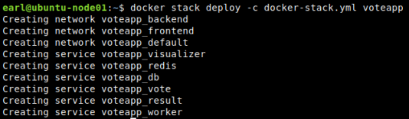
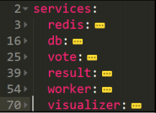
Ejercicio
Si desea entender el comportamiento de Docker stack, siga paso a paso el capítulo 7 del libro guía de Docker. Allí despliegan una aplicación de votaciones online, con Docker Swarm y Docker stack compuesta de 6 servicios diferentes.
https://github.com/dockersamples/example-voting-app/blob/master/docker-stack.yml

Slide 48
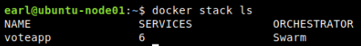
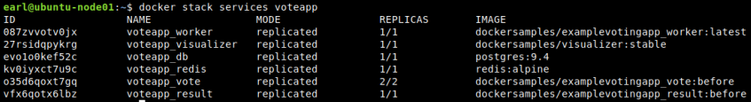
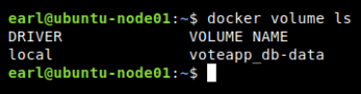
Ejemplo – Docker stack

Slide 49
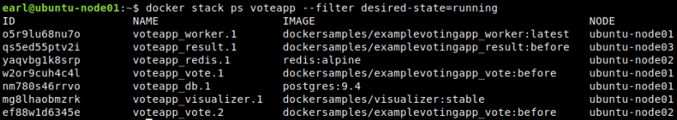
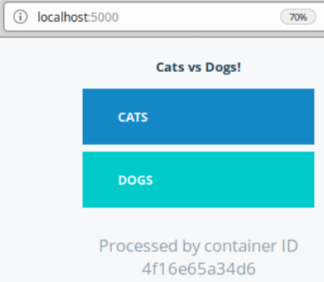
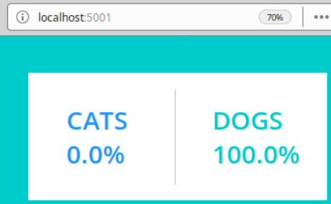
Ejemplo – Docker stack – II

Slide 50
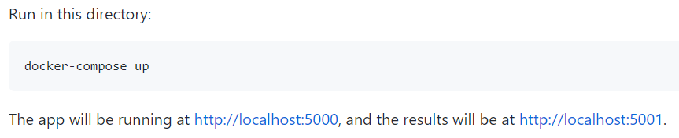
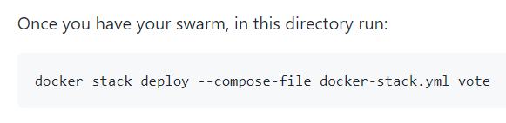
Sugerencias para completar el ejercicio
Primero en una maquina virtual (VM) simple con Docker, instalele Docker-compose (https://www.digitalocean.com/community/tutorials/how-to-install-docker-compose-on-debian-10) -> en el primer comando cambie “1.25.3” por “1.27.3”. Y a la maquina virtual ábrale los puertos 5000 y 5001.
Luego descargue su VM este repo: https://github.com/dockersamples/example-voting-app
Luego ejecute (con sudo):
Abra las rutas de la imagen anterior (basado en la ip de su VM) desde su celular con datos y le deben funcionar (el wifi de la u a veces bloquea acceso a puertos que no son el 80).
Finalmente, borre los contenedores creados, luego cree un pequeño enjambre (con 1 líder y un manager), y corra lo siguiente (con sudo):

Slide 51
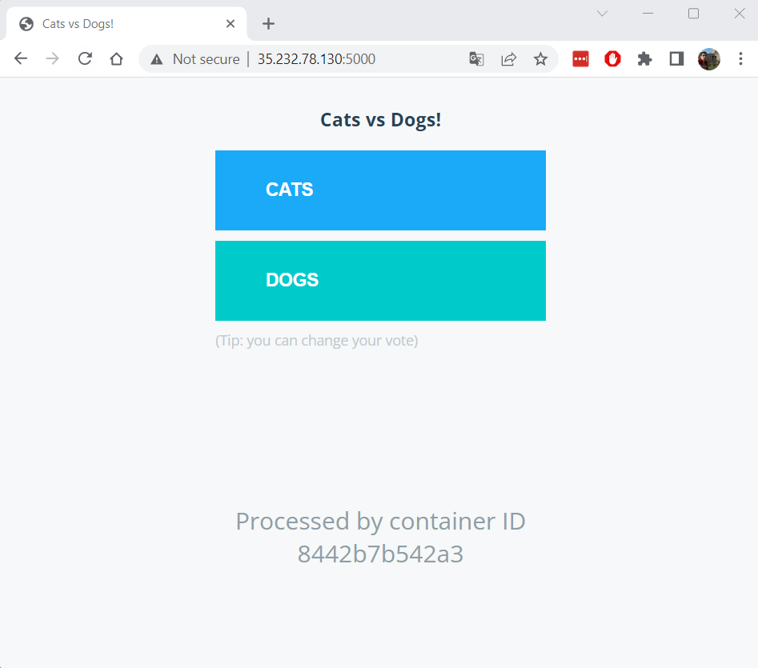
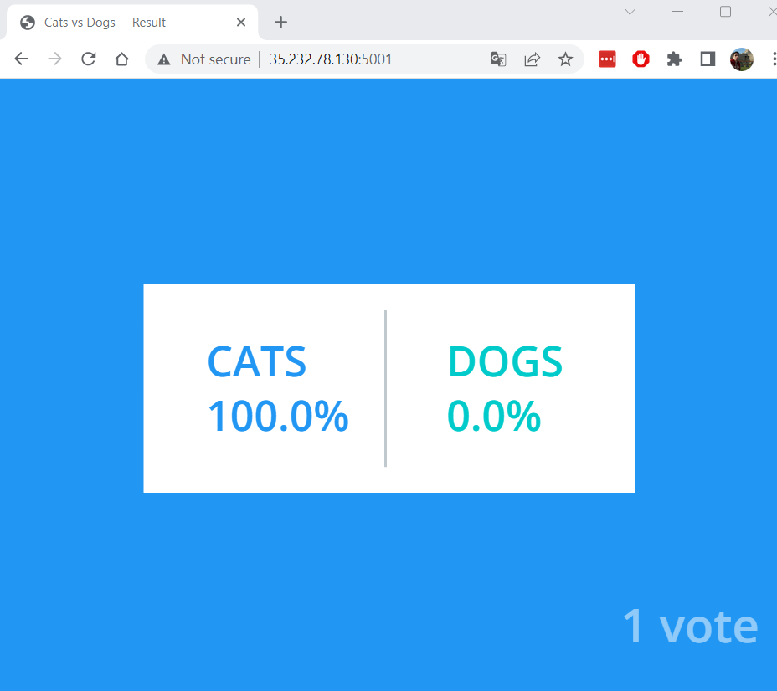

Slide 52

Recapitulemos
Hasta este punto debemos saber:
¿Qué es un microservicio?
¿Cuáles son los beneficios de los microservicios?
¿Qué es Docker Swarm y para qué sirve?
¿Qué es Docker service y para qué sirve?
¿Qué es Docker compose y para qué sirve?
¿Qué es Docker stack y para qué sirve?

Slide 53
Avisos Parroquiales
Próxima Semana Parcial 2.
17 de Mayo Sustentación Proyecto 2.
Taller 2 entrega 31 de Mayo 11:59 pm.

Slide 54
Referencias
Bass, L., Clements, P., & Kazman, R. (2012). Software architecture in practice, 3rd Ed. Addison-Wesley Professional.
Correa, D. & Vallejo, P. (2022). Practical Laravel: Develop clean MVC web applications.
Martin, R. (2017). Clean Architecture: A Craftsman’s Guide to Software Structure and Design.
Stauffer, M. (2019). Laravel: Up & Running: A Framework for Building Modern PHP Apps. O'Reilly Media.
Waud, E. (2018). Docker Quick Start Guide: Learn Docker like a boss, and finally own your applications. Packt Publishing Ltd.

